Slide 1
Intro to FTC Setup and Code
Welcome back, and Don’t panic!
https://github.com/JimWright4089/FIRSTWorkshops

Slide 2
Intro
Things covered in this class:
Setting up the Hardware
Block Programming
OnBot Java

Slide 3
Setting up the Hardware
OMG! The number of configuration is larger than 2019.
REV Robotics will not have Control Hubs / Expansion Hubs for this season. We need to reuse as much as possible.
REV Robotics has a tool.
https://github.com/JimWright4089/FIRSTWorkshops

Slide 4
Expansion Hubs are the key
Most old teams have extra Expansion Hubs, ask around.
Phone to expansion hub needs weird cable, a Micro B USB to Mini B USB.
Can be built out of a OTG Micro B to A Socket, then an A to Mini B.
https://github.com/JimWright4089/FIRSTWorkshops

Slide 5
Minimum setup
You need two phones
One Expansion Hub
Up to Four SPARKmini Motor Controllers (still in stock)
This will give you 4-8 DC motors and 6-2 servo motors.
https://github.com/JimWright4089/FIRSTWorkshops

Slide 6
Best non-Control Hub setup
You need one phone
Two Expansion Hubs
One Drivers Hub (still in stock)
https://github.com/JimWright4089/FIRSTWorkshops

Slide 7
Best setup
One Control Hub
One Expansion Hubs
One Drivers Hub (still in stock)
https://github.com/JimWright4089/FIRSTWorkshops

Slide 8
REV Robotics Tool
REV has an amazing tool to update firmware.
https://github.com/REVrobotics/REV-Software-Binaries.
REV-Hardware-Client-Setup-1.4.3.exe
We require the default password to be changed. If you do, you can find what it’s set to through this tool!
https://github.com/JimWright4089/FIRSTWorkshops

Slide 9
Setting up the phones
The software is no longer on Google Play.
REV Hardware Client to the rescue
You can download either the Robot Controller or the Drivers Station
https://github.com/JimWright4089/FIRSTWorkshops

Slide 10
Setting up the phones/ or other junk
Under the settings you will find tools to set the names of the phones or other junk.
<team number>-DS for Driver station
<team number>-RC for Robot Controller
Spare thingys use letters between the team number and the –XX. Like 4444-B-RC

Slide 11
Setting up the phones
Connect the Driver station to a joystick, or hub with two joysticks connected to it, through a OTG cable.
Connect the Robot Controller to the Robot through a Mini B to Micro B cable.

Slide 12
Configuring the robot.
You need to configure the robot’s hardware.
Go into the driver’s station settings panel and choose Configure Robot.
If there are configuration on this page and you did not put them there, delete them, because they are for older robots.
Create a new configuration.

Slide 13
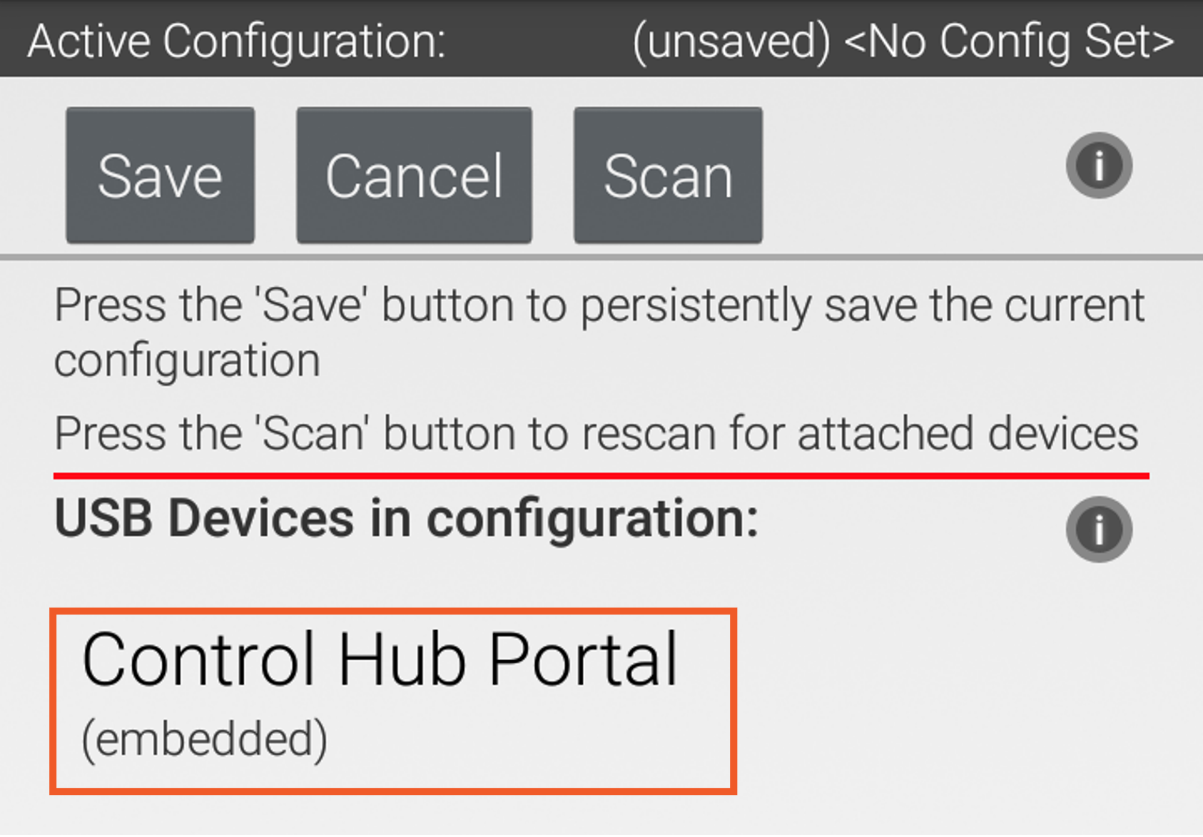
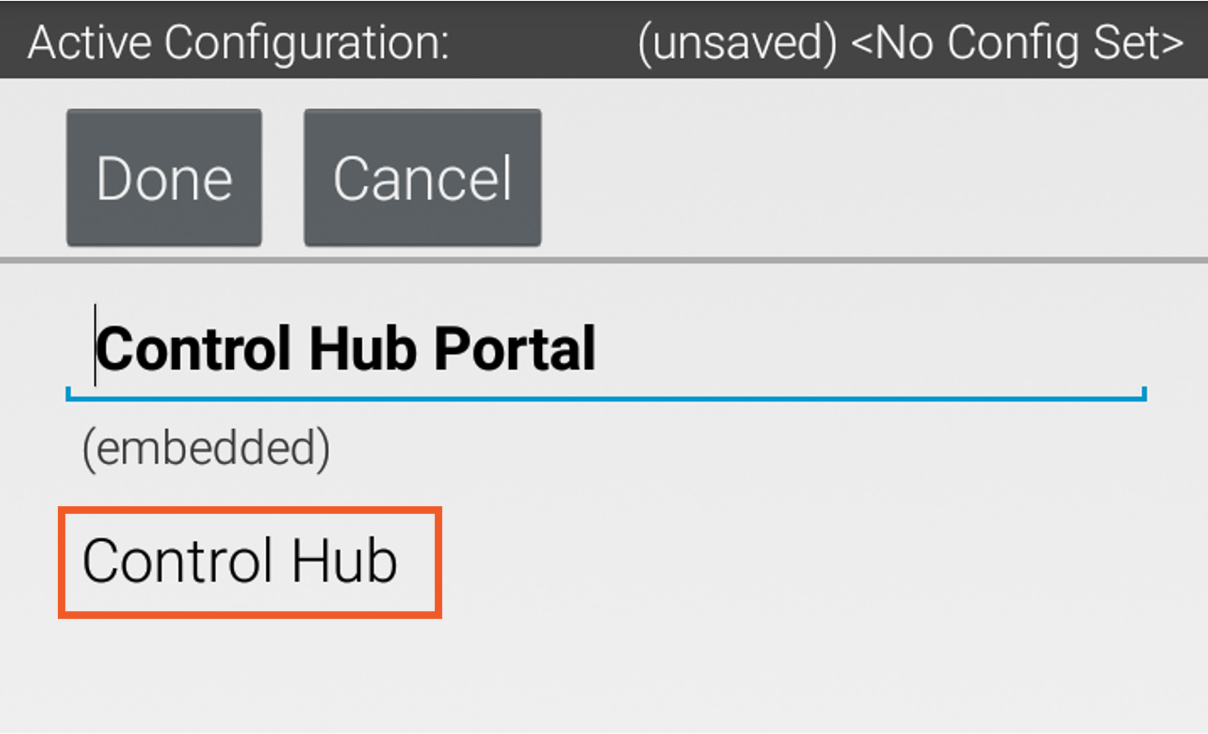
Configuring the robot.

Slide 14
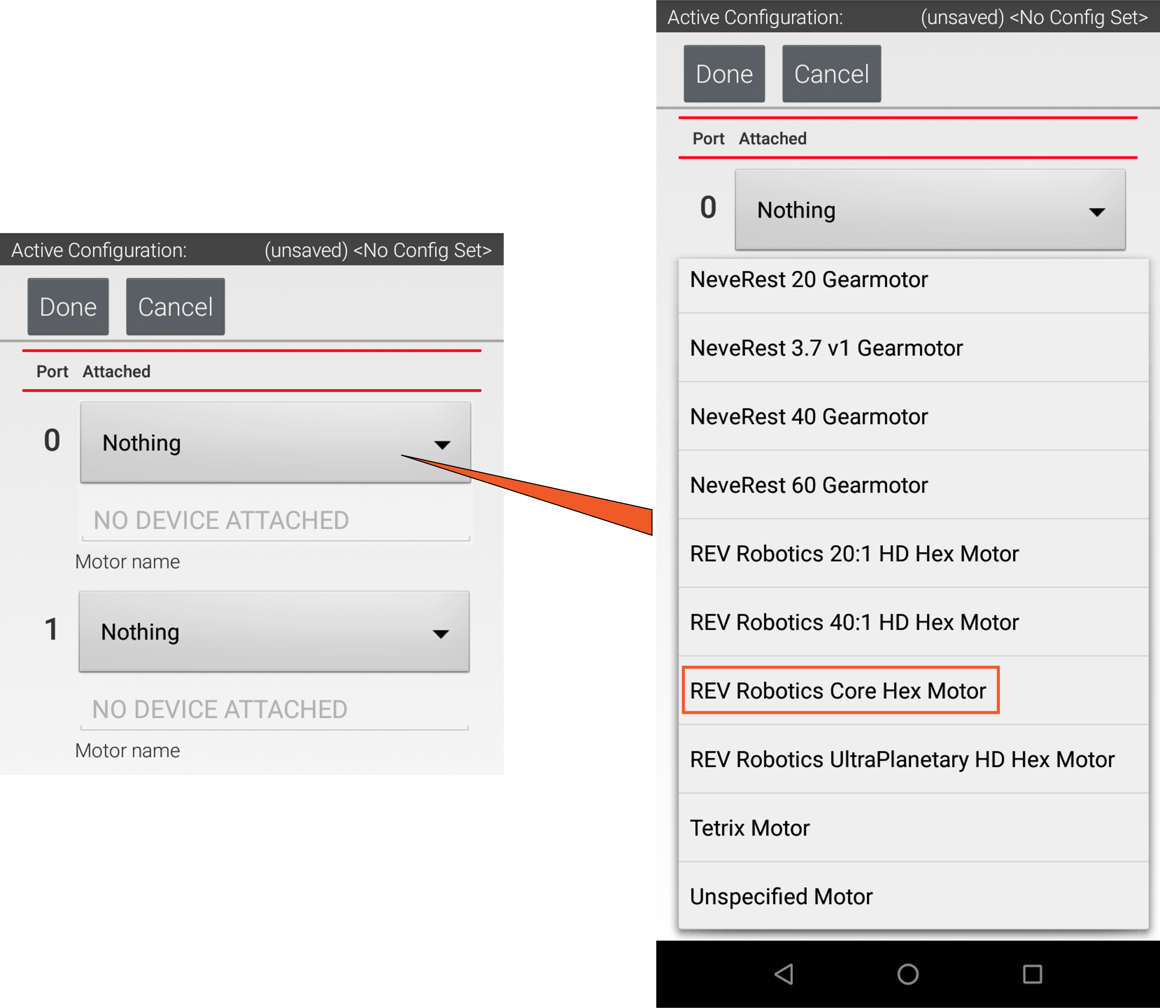
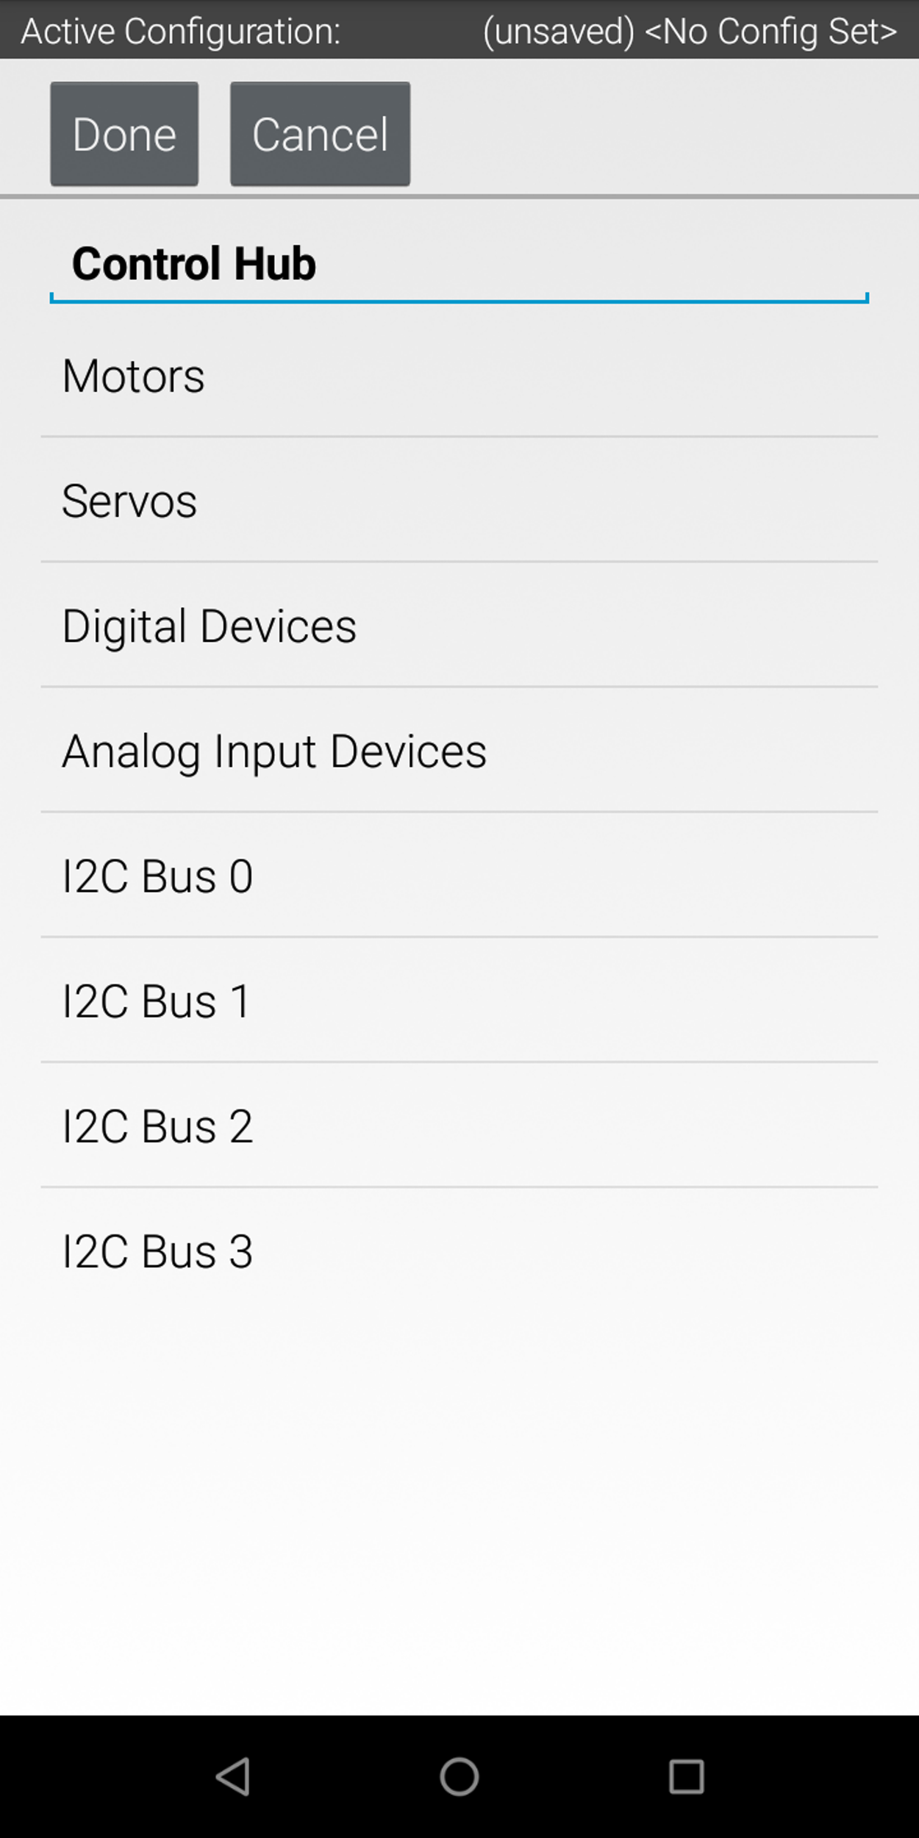
Configuring the robot.

Slide 15
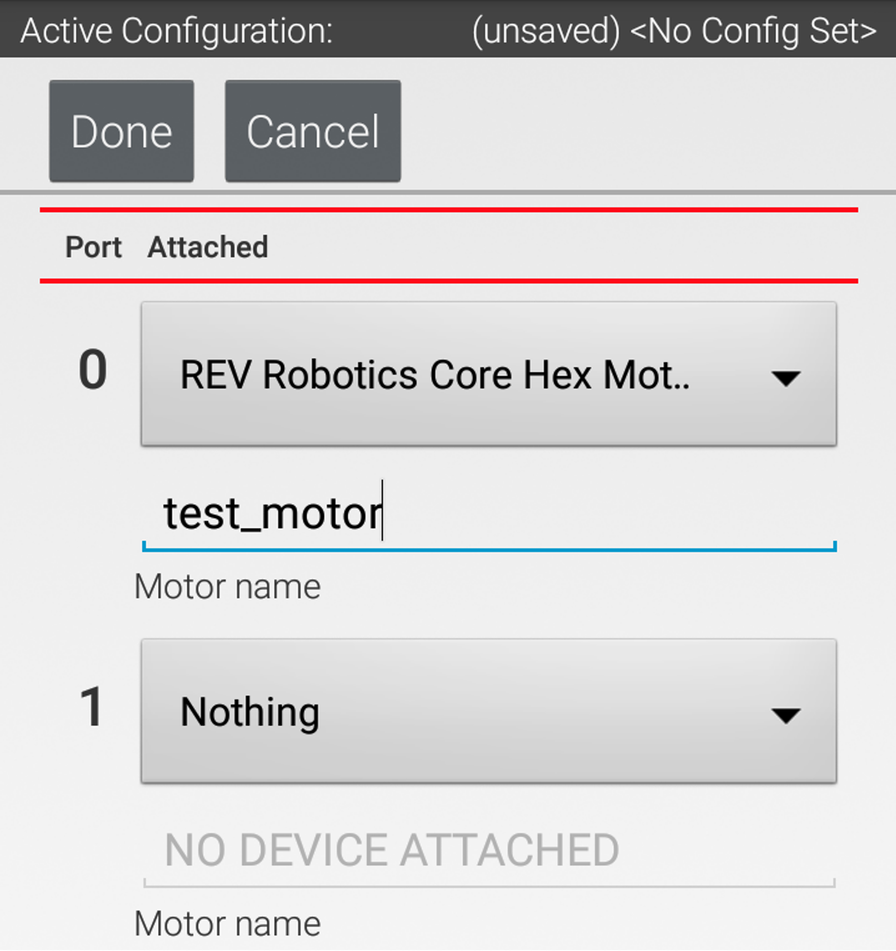
Configuring the robot.
In naming things make sure your write the exact name on a sheet of paper. You will need the EXACT name (caps and underscores count) for the program.

Slide 16
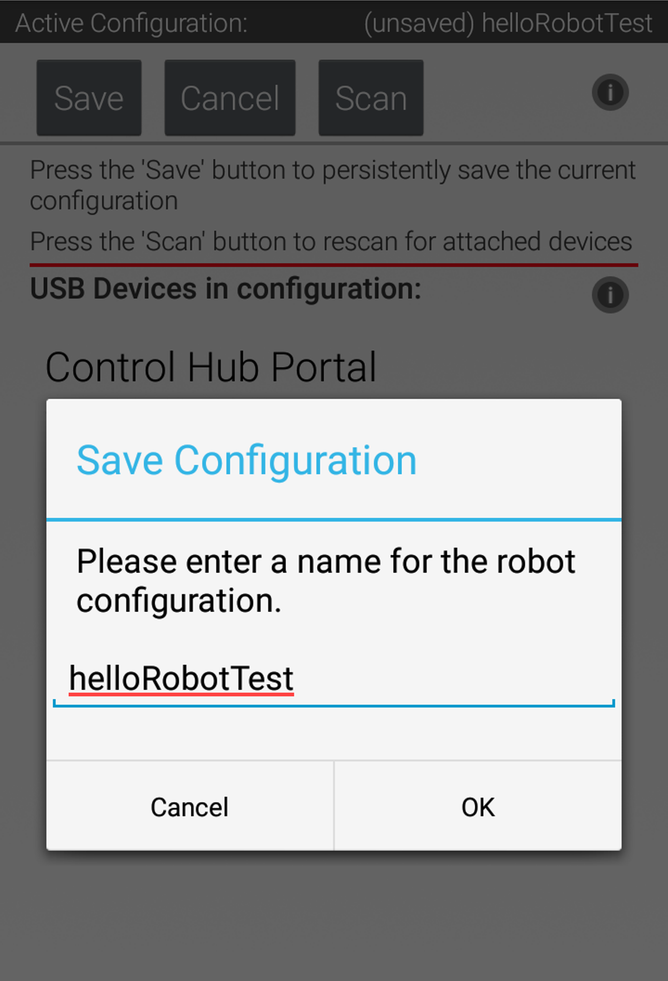
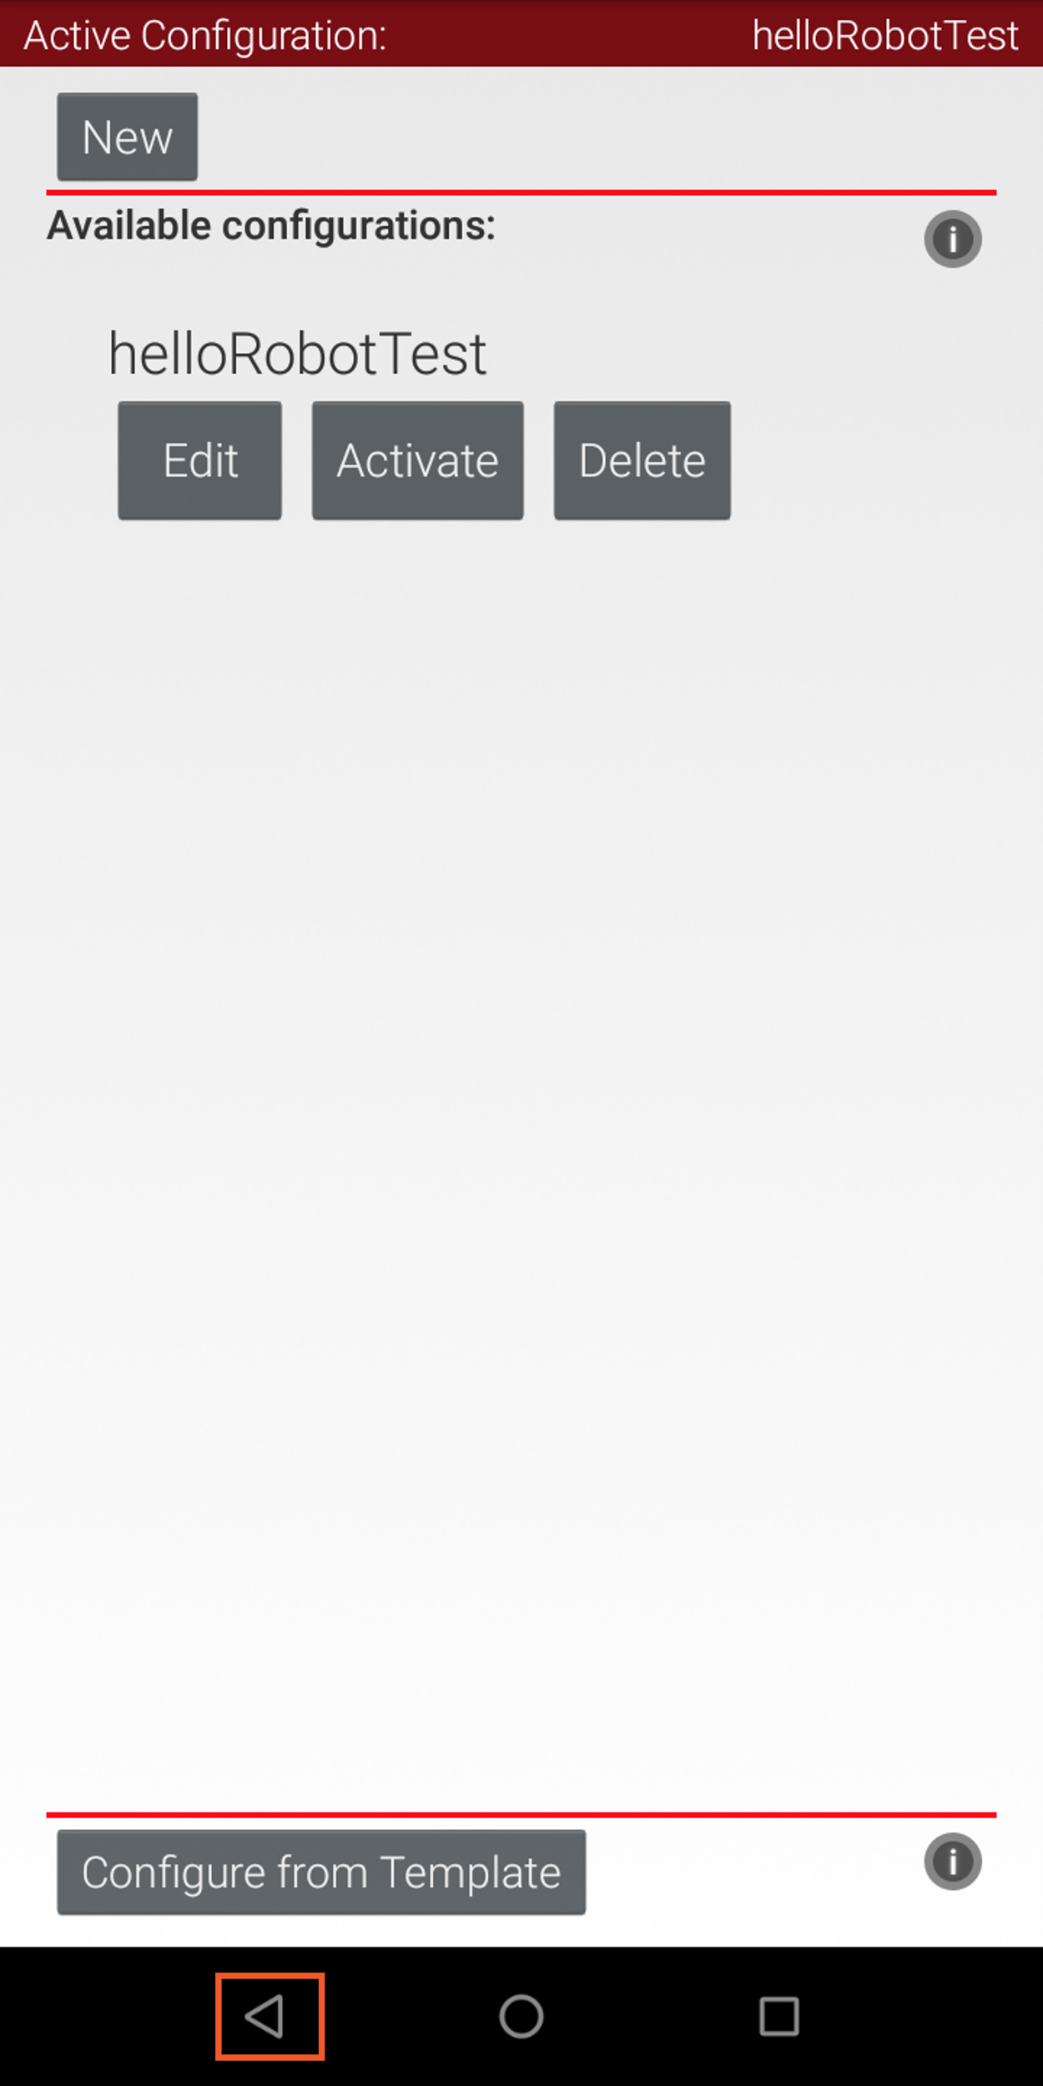
Configuring the robot.
Click on back until you can a ‘save’ option. Save the config as a name, and then Activate it.
The current config is in the upper right corner.

Slide 17
Programming
You have a bunch of ways to program your robot.
Block
OnBot Java
Andriod Studio

Slide 18
Kevin Ross is really smart.
I like using OnBot Java for my personal robots.
It’s quick and easy. I’ve been doing this since 2016.
However, it requires you to connect your WiFi to the robot. So to look stuff up on the internet you need to disconnect from the robot and connect back to the Internet.
Kevin pointed out we can get a Wifi/USB dongle and connect that to the internet.

Slide 19
Block and OnBot connection.
You will enable another WIFI connection to the Robot Controller
Use the Program and Manage menu item.
From this panel you will see the WIFI name and WIFI key for the robot controller

Slide 20
Block and OnBot connection.
You will enable another WIFI connection to the Robot Controller
Use the Program and Manage menu item.
From this panel you will see the WIFI name and WIFI key for the robot controller.
Point your browser to the IP address on the RC. Something like:
http://192.168.49.1:8080

Slide 21
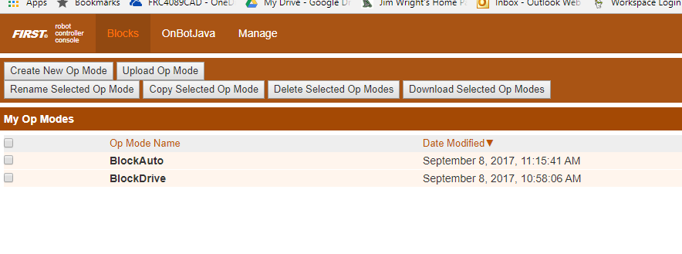
Block
Screen:

Slide 22
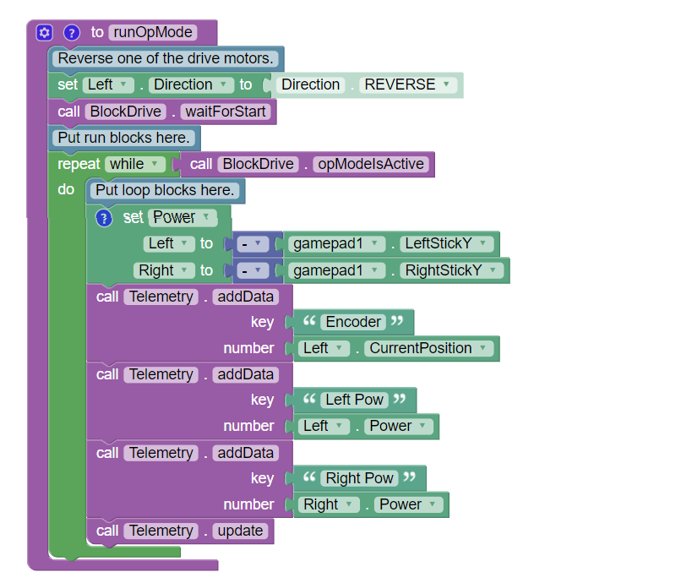
Block

Slide 23
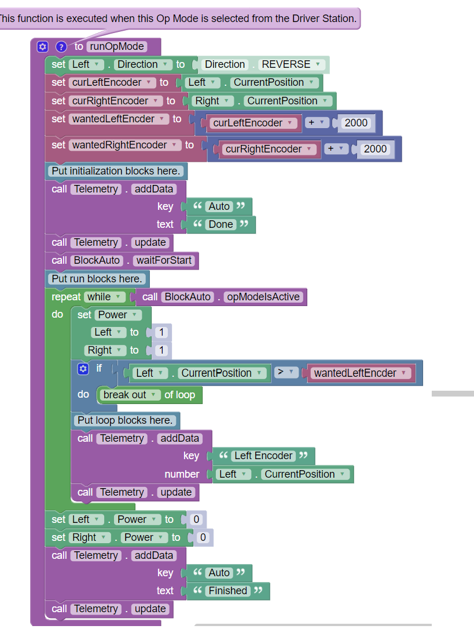
Block

Slide 24
OnBot
Standard Java, just on the robot!

Slide 25
OnBot
rightMotor = hardwareMap.dcMotor.get("Right");
rightMotor.setDirection(DcMotor.Direction.REVERSE);// Set to FORWARD if using AndyMark motors
rightMotor.setMode(DcMotor.RunMode.STOP_AND_RESET_ENCODER);
rightMotor.setMode(DcMotor.RunMode.RUN_WITHOUT_ENCODER);
waitForStart();
runtime.reset();

Slide 26
OnBot
while (opModeIsActive()) {
Integer rightEnc = rightMotor.getCurrentPosition();
telemetry.addData("Status", "Run Time: " + runtime.toString());
telemetry.addData("R Enocder", rightEnc.toString());
telemetry.update();
leftMotor.setPower(-gamepad1.left_stick_y);
rightMotor.setPower(-gamepad1.right_stick_y);

